Slide 1
DSP project
Sensor calibration using low pass filters

Slide 2
Introduction
sfsfs

Slide 3
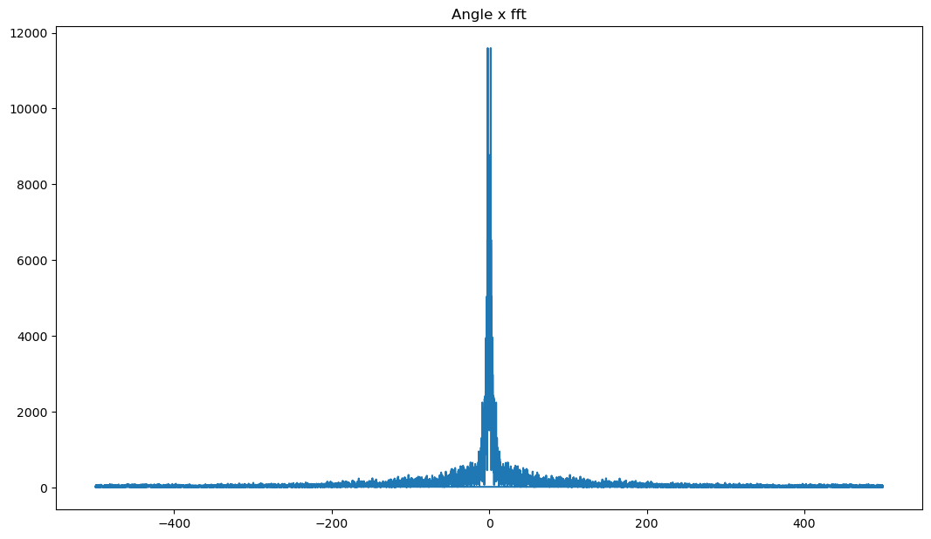
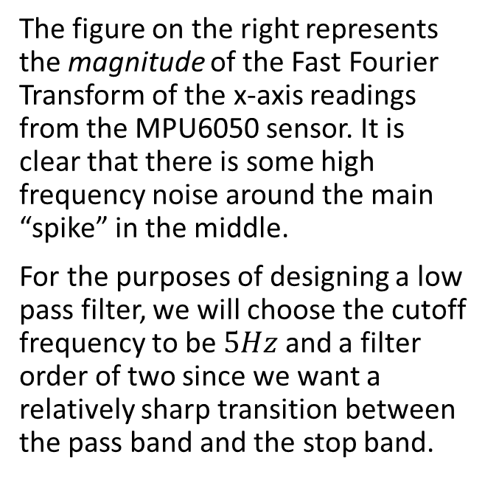
Filter design
The figure on the right represents the magnitude of the Fast Fourier Transform of the x-axis readings from the MPU6050 sensor. It is clear that there is some high frequency noise around the main “spike” in the middle.
For the purposes of designing a low pass filter, we will choose the cutoff frequency to be $5Hz$ and a filter order of two since we want a relatively sharp transition between the pass band and the stop band.
FFT transform of the x-axis readings from the MPU6050

Slide 4
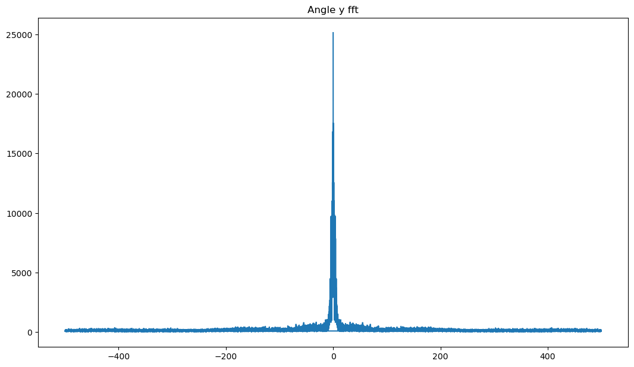
Filter design
The figure on the right represents the magnitude of the Fast Fourier Transform of the y-axis readings from the MPU6050 sensor.
The FFT result is similar to that of the x-axis FFT result. Therefore, we will choose the same filter for the sensor’s y-axis component.
FFT transform of the y-axis readings from the MPU6050

Slide 5
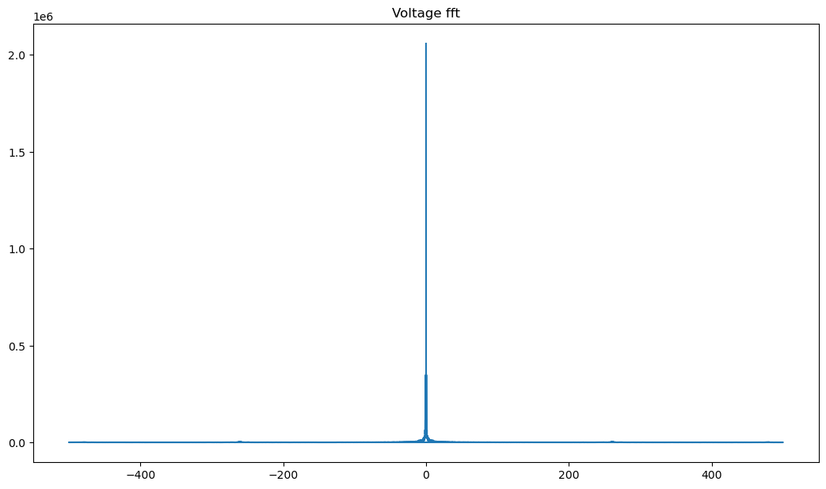
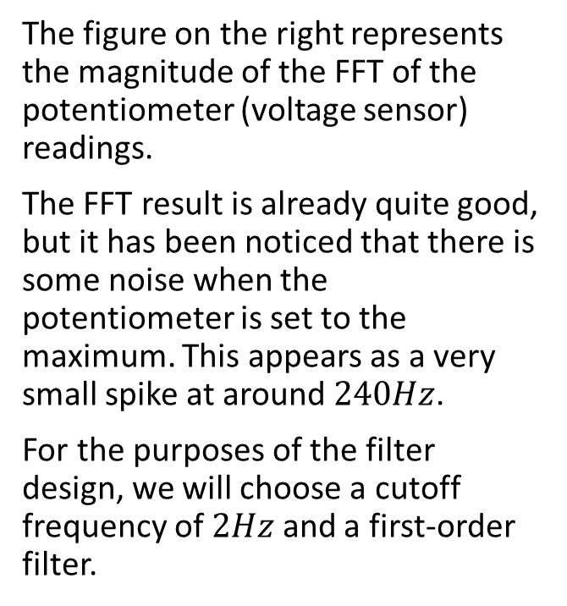
Filter design
The figure on the right represents the magnitude of the FFT of the potentiometer (voltage sensor) readings.
The FFT result is already quite good, but it has been noticed that there is some noise when the potentiometer is set to the maximum. This appears as a very small spike at around $240Hz$.
For the purposes of the filter design, we will choose a cutoff frequency of $2Hz$ and a first-order filter.
FFT transform of the y-axis readings from the MPU6050

Slide 6
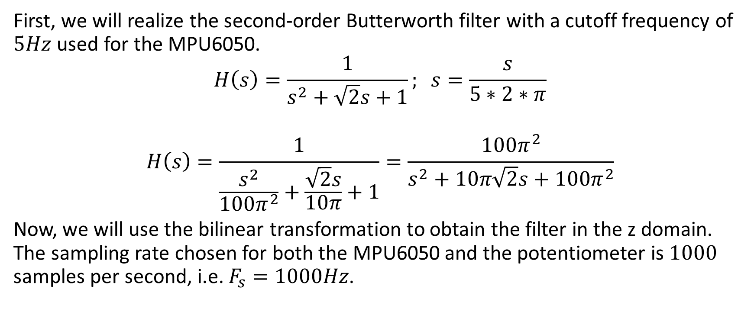
Filter Realization
First, we will realize the second-order Butterworth filter with a cutoff frequency of $5Hz$ used for the MPU6050.
$$H\left(s\right)=\frac{1}{s^{2}+\sqrt{2}s+1}; s=\frac{s}{5∗2∗π}$$
$$H\left(s\right)=\frac{1}{\frac{s^{2}}{100π^{2}}+\frac{\sqrt{2}s}{10π}+1}=\frac{100π^{2}}{s^{2}+10π\sqrt{2}s+100π^{2}}$$
Now, we will use the bilinear transformation to obtain the filter in the z domain. The sampling rate chosen for both the MPU6050 and the potentiometer is $1000$ samples per second, i.e. $F_{s}=1000Hz$.

Slide 7
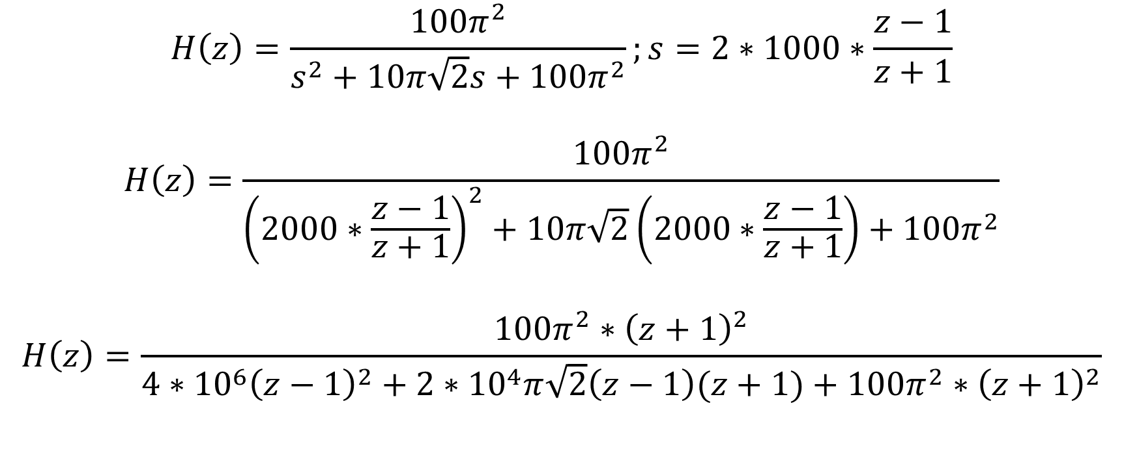
Filter Realization
$$H\left(z\right)=\frac{100π^{2}}{s^{2}+10π\sqrt{2}s+100π^{2}};s=2∗1000∗\frac{z−1}{z+1}$$
$$H\left(z\right)=\frac{100π^{2}}{{\left(2000∗\frac{z−1}{z+1}\right)}^{2}+10π\sqrt{2}\left(2000∗\frac{z−1}{z+1}\right)+100π^{2}}$$
$$H\left(z\right)=\frac{100π^{2}∗{\left(z+1\right)}^{2}}{4∗{10}^{6}{\left(z−1\right)}^{2}+2∗{10}^{4}π\sqrt{2}\left(z−1\right)(z+1)+100π^{2}∗{\left(z+1\right)}^{2}}$$

Slide 8
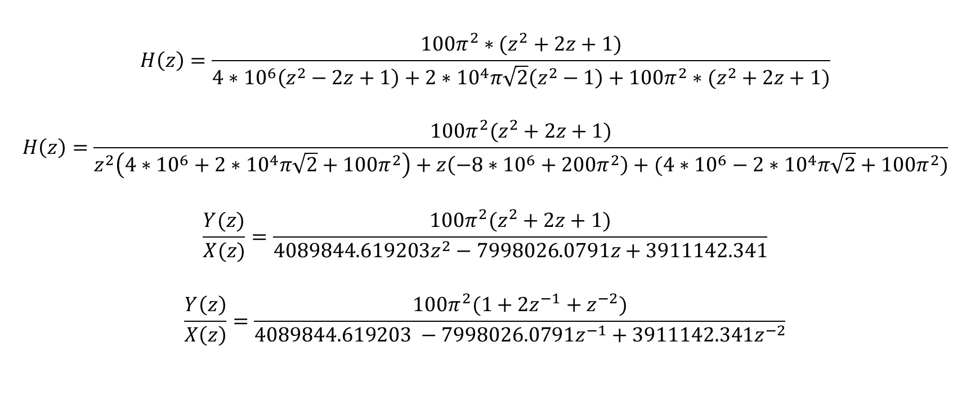
Filter Realization
$$H\left(z\right)=\frac{100π^{2}∗(z^{2}+2z+1)}{4∗{10}^{6}\left(z^{2}−2z+1\right)+{2∗10}^{4}π\sqrt{2}\left(z^{2}−1\right)+100π^{2}∗(z^{2}+2z+1)}$$
$$H\left(z\right)=\frac{100π^{2}(z^{2}+2z+1)}{z^{2}\left(4∗{10}^{6}+2∗{10}^{4}π\sqrt{2}+100π^{2}\right)+z\left(−8∗{10}^{6}+200π^{2}\right)+(4∗{10}^{6}−2∗{10}^{4}π\sqrt{2}+100π^{2})}$$
$$\frac{Y(z)}{X(z)}=\frac{100π^{2}(z^{2}+2z+1)}{4089844.619203z^{2}−7998026.0791z+3911142.341}$$
$$\frac{Y\left(z\right)}{X\left(z\right)}=\frac{100π^{2}(1+2z^{−1}+z^{−2})}{4089844.619203 −7998026.0791z^{−1}+3911142.341z^{−2}}$$

Slide 9
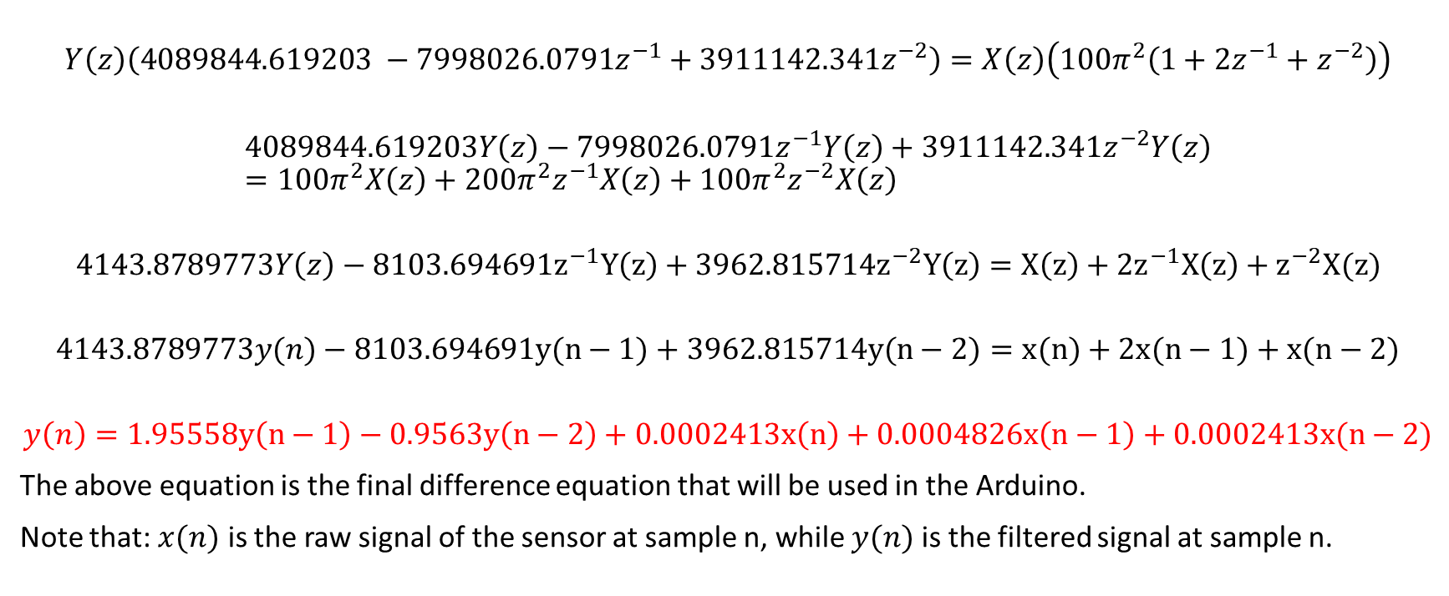
Filter Realization (Z-Inverse)
$$Y\left(z\right)\left(4089844.619203 −7998026.0791z^{−1}+3911142.341z^{−2}\right)=X\left(z\right)\left(100π^{2}\left(1+2z^{−1}+z^{−2}\right)\right)$$
$$4089844.619203Y\left(z\right)−7998026.0791z^{−1}Y\left(z\right)+3911142.341z^{−2}Y\left(z\right)=100π^{2}X\left(z\right)+200π^{2}z^{−1}X\left(z\right)+100π^{2}z^{−2}X\left(z\right)$$
$$4143.8789773Y\left(z\right)−8103.694691z^{−1}Y\left(z\right)+3962.815714z^{−2}Y\left(z\right)=X\left(z\right)+2z^{−1}X\left(z\right)+z^{−2}X(z)$$
$$4143.8789773y(n)−8103.694691y(n−1)+3962.815714y(n−2)=x(n)+2x(n−1)+x(n−2)$$
$$y\left(n\right)=1.95558y\left(n−1\right)−0.9563y\left(n−2\right)+0.0002413x\left(n\right)+0.0004826x\left(n−1\right)+0.0002413x(n−2)$$
The above equation is the final difference equation that will be used in the Arduino.
Note that: $x(n)$ is the raw signal of the sensor at sample n, while $y(n)$ is the filtered signal at sample n.

Slide 10
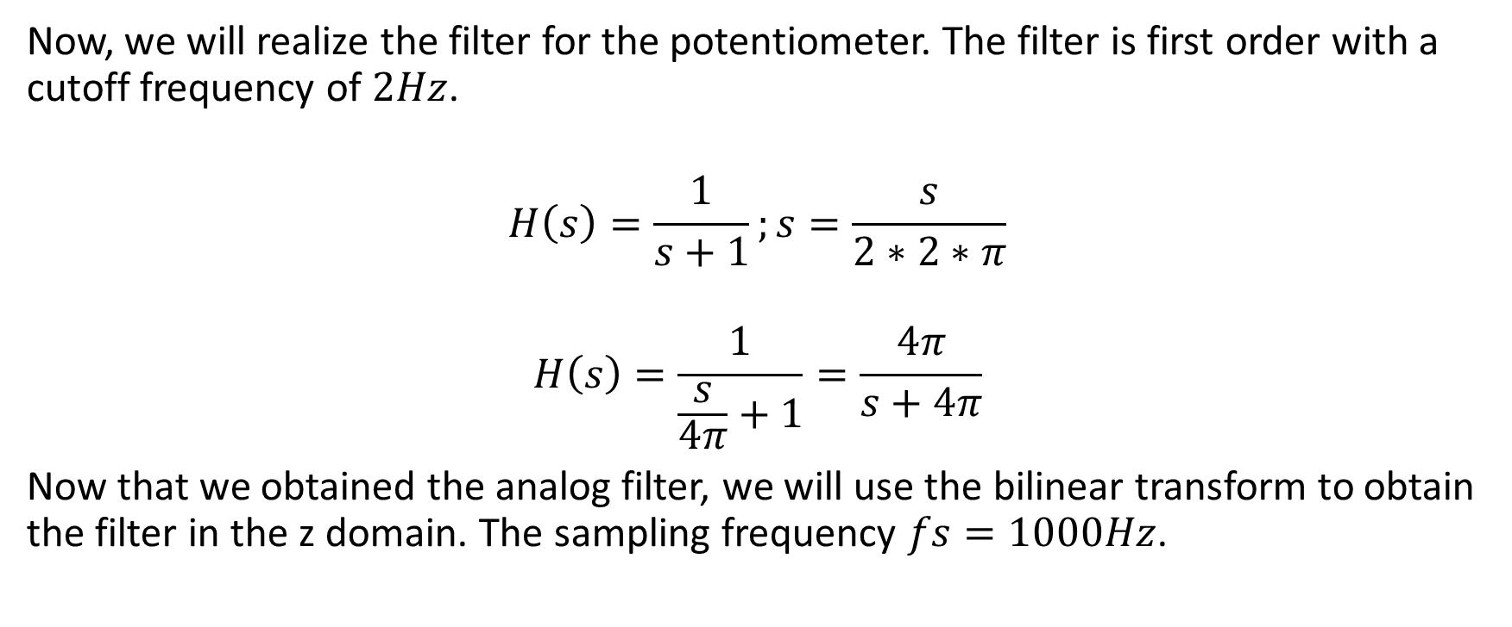
Filter Realization
Now, we will realize the filter for the potentiometer. The filter is first order with a cutoff frequency of $2Hz$.
$$H\left(s\right)=\frac{1}{s+1};s=\frac{s}{2∗2∗π}$$
$$H\left(s\right)=\frac{1}{\frac{s}{4π}+1}=\frac{4π}{s+4π}$$
Now that we obtained the analog filter, we will use the bilinear transform to obtain the filter in the z domain. The sampling frequency $fs=1000Hz$.

Slide 11
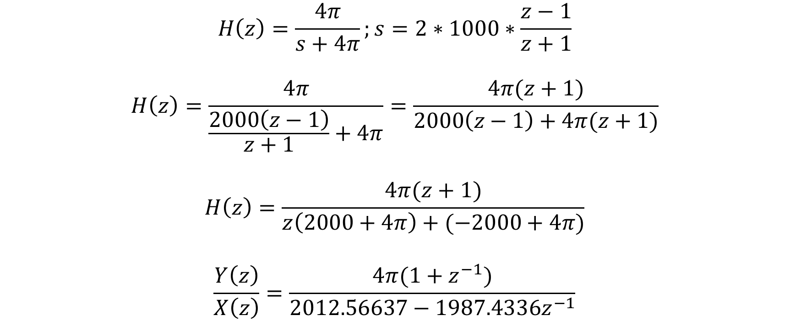
Filter Realization
$$H\left(z\right)=\frac{4π}{s+4π};s=2∗1000∗\frac{z−1}{z+1}$$
$$H\left(z\right)=\frac{4π}{\frac{2000\left(z−1\right)}{z+1}+4π}=\frac{4π(z+1)}{2000\left(z−1\right)+4π(z+1)}$$
$$H\left(z\right)=\frac{4π(z+1)}{z\left(2000+4π\right)+(−2000+4π)}$$
$$\frac{Y\left(z\right)}{X\left(z\right)}=\frac{4π(1+z^{−1})}{2012.56637−1987.4336z^{−1}}$$

Slide 12
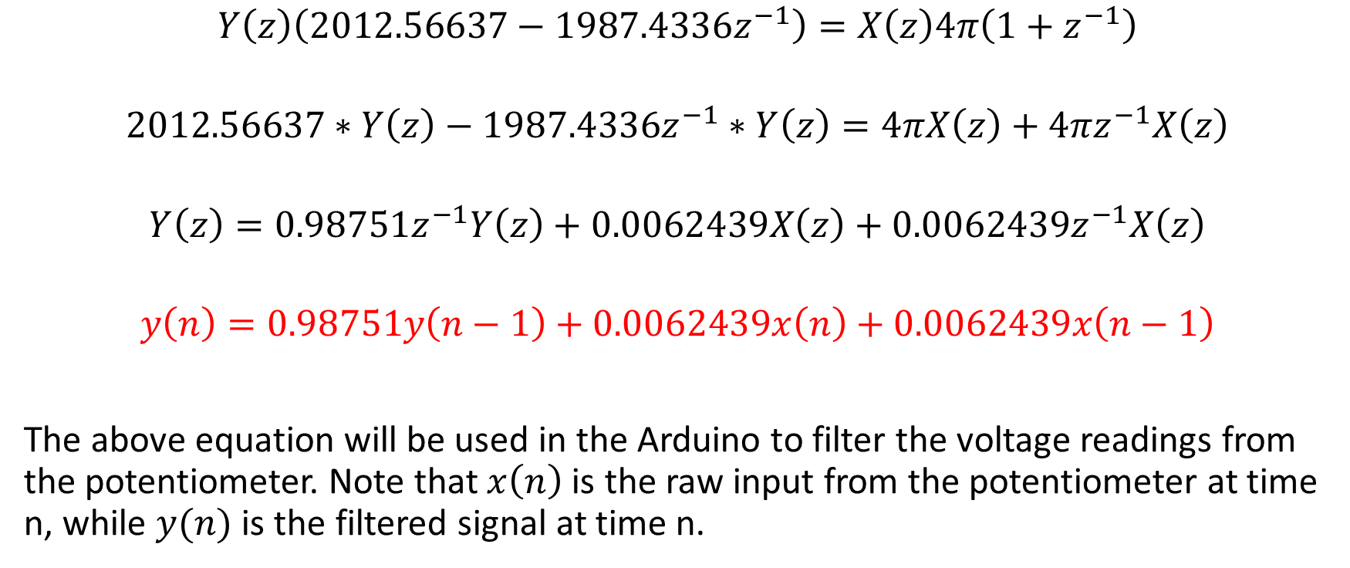
Filter Realization (Z-Inverse)
$$Y\left(z\right)\left(2012.56637−1987.4336z^{−1}\right)=X\left(z\right)4π\left(1+z^{−1}\right)$$
$$2012.56637∗Y\left(z\right)−1987.4336z^{−1}∗Y\left(z\right)=4πX\left(z\right)+4πz^{−1}X\left(z\right)$$
$$Y\left(z\right)=0.98751z^{−1}Y\left(z\right)+0.0062439X\left(z\right)+0.0062439z^{−1}X\left(z\right)$$
$$y\left(n\right)=0.98751y\left(n−1\right)+0.0062439x\left(n\right)+0.0062439x\left(n−1\right)$$
The above equation will be used in the Arduino to filter the voltage readings from the potentiometer. Note that $x\left(n\right)$ is the raw input from the potentiometer at time n, while $y(n)$ is the filtered signal at time n.

